Slide 1
SC-407 and MC-226
Sun’s Diurnal Motion in the Sky

Slide 2
Definitions
Declination
Represents how far north or south a celestial object is from the CEP, measured at the center of the Earth
Analogous to latitude on the Earth's surface
Elevation
Sometimes called altitude, is an angular measurement used to specify the angular distance above the horizon at which a celestial object is located
Measured in the local horizon plane on the Earth’s surface
Summary
Declination and latitude are the vertical (North-South) angles measured at the center of the Earth
Former for the heavenly bodies and the latter for the positions on the Earth surface
Elevation and altitude are also the vertical angles of a celestial body but they are measured in the local horizon plane

Slide 3
Definitions
Longitude
Measurement of the horizontal (East-West) angle at the Earth’s center of an object’s location on the surface of the Earth
Azimuth Angle is the measurement of the horizontal angle for the celestial bodies. It can either be
the angle at the Earth’s center relative to, say, the Vernal Equinox direction, or
the angle in the local horizon plane at the Earth’s surface in the ENU coordinates

Slide 4
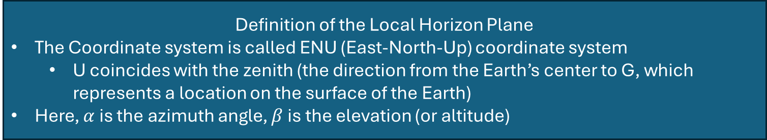
Definition of the Local Horizon Plane
The Coordinate system is called ENU (East-North-Up) coordinate system
U coincides with the zenith (the direction from the Earth’s center to G, which represents a location on the surface of the Earth)
Here, $α$ is the azimuth angle, $β$ is the elevation (or altitude)
G

Slide 5
Summer Solstice
3D Solar Trajectory

Slide 6
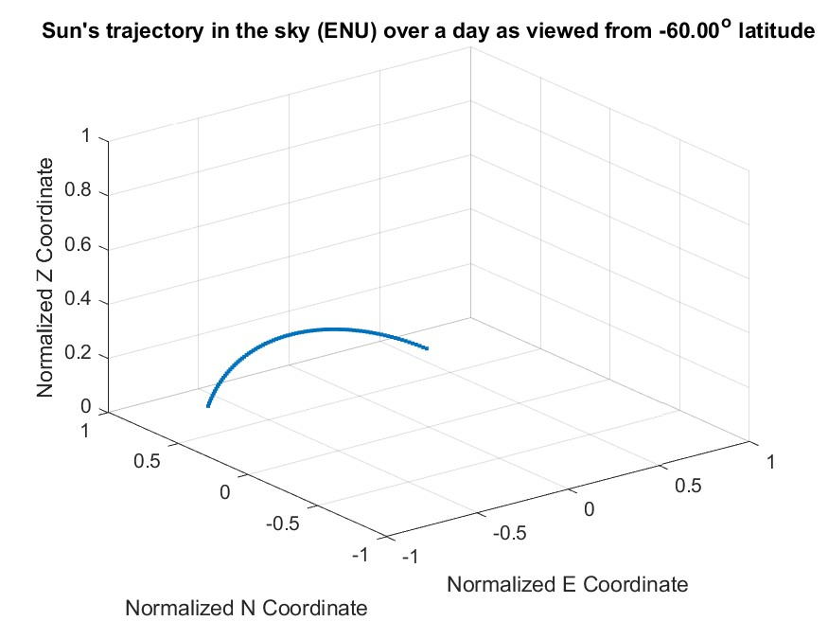

Slide 7
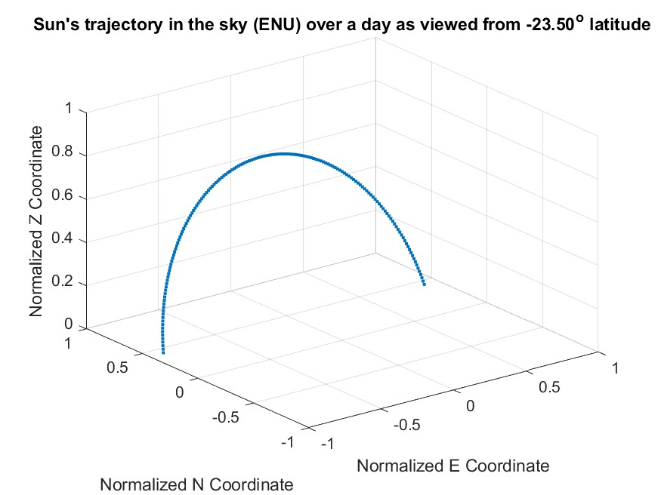

Slide 8
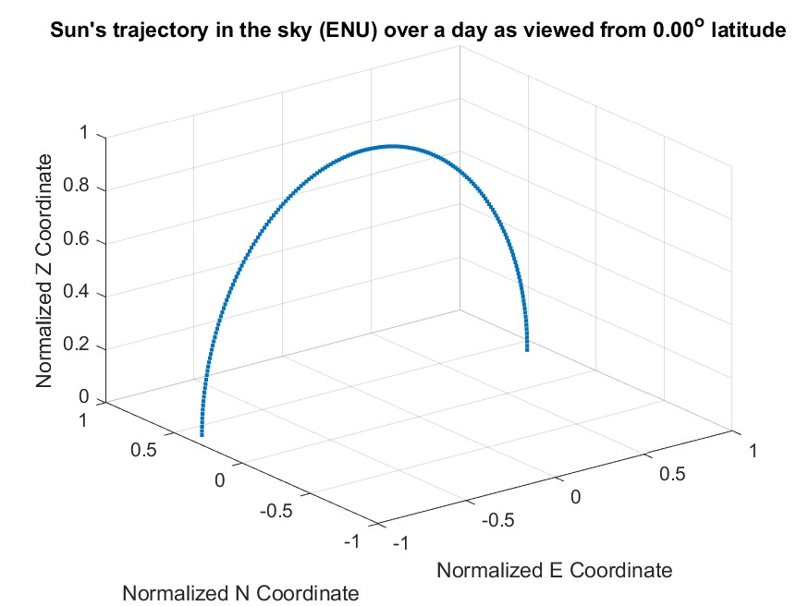

Slide 9
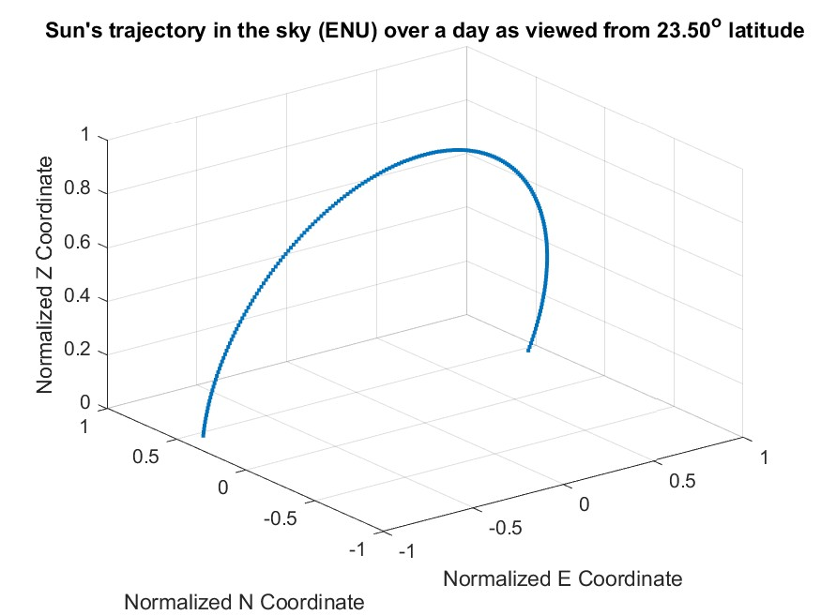

Slide 10
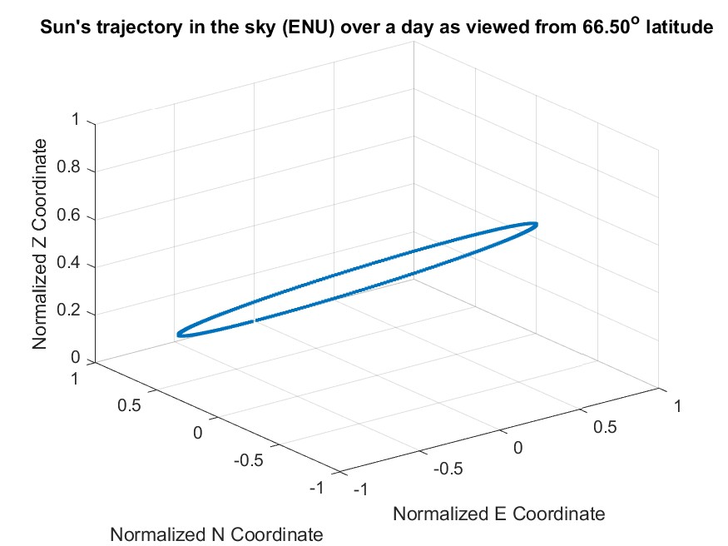

Slide 11
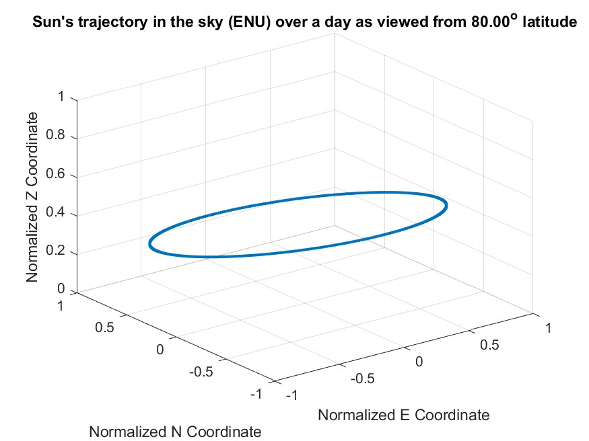

Slide 12
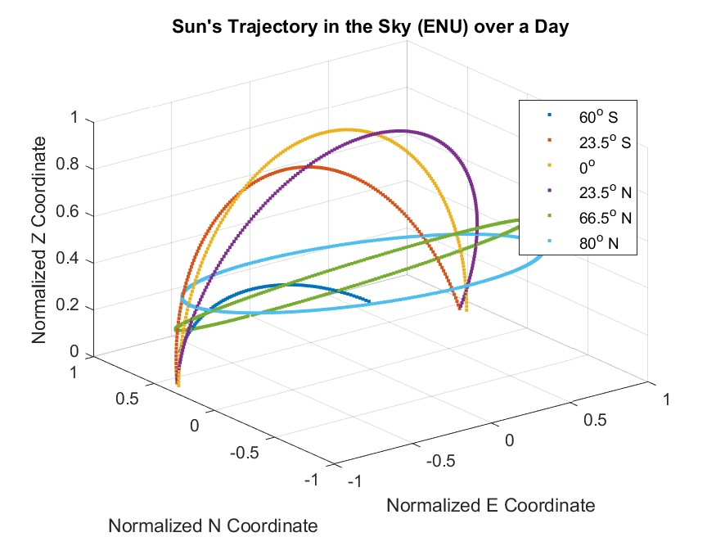

Slide 13
Summer Solstice
Elevation of the Sun observed over a Day

Slide 14
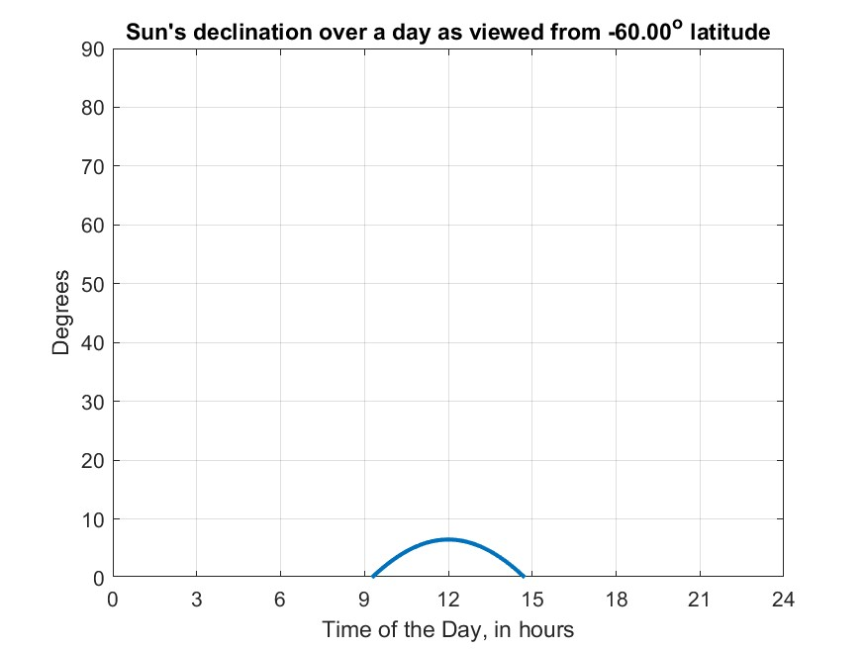
elevation

Slide 15
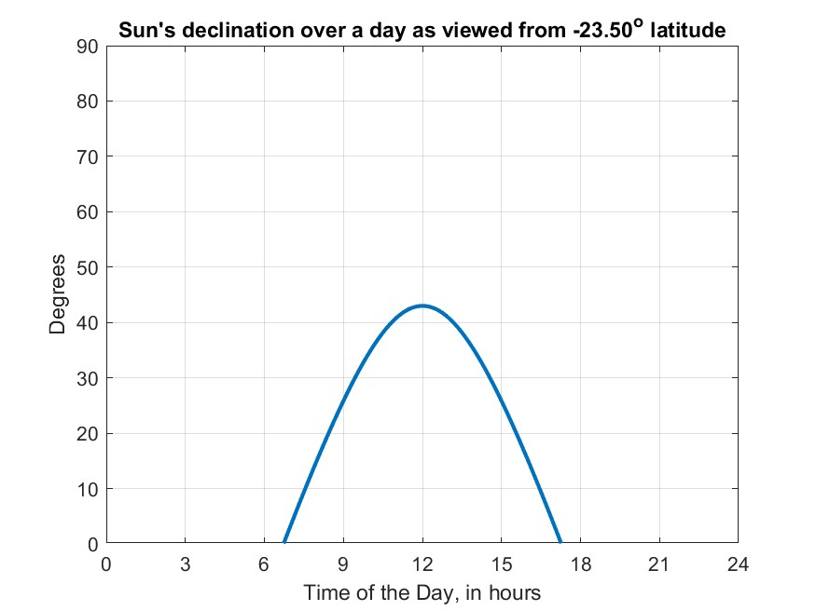
elevation

Slide 16
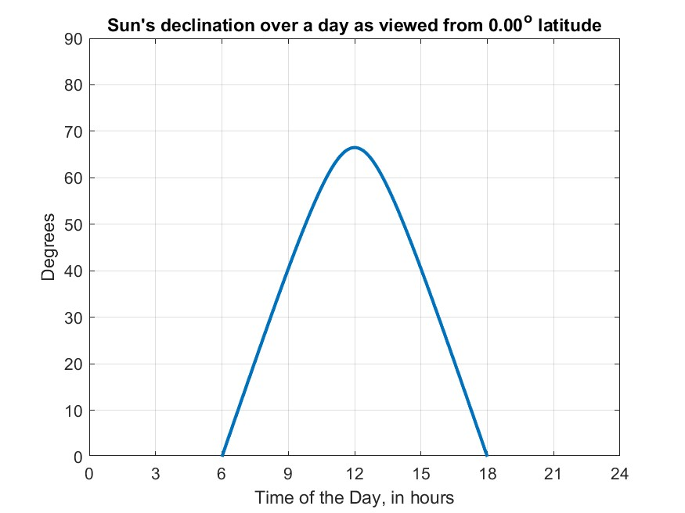
elevation

Slide 17
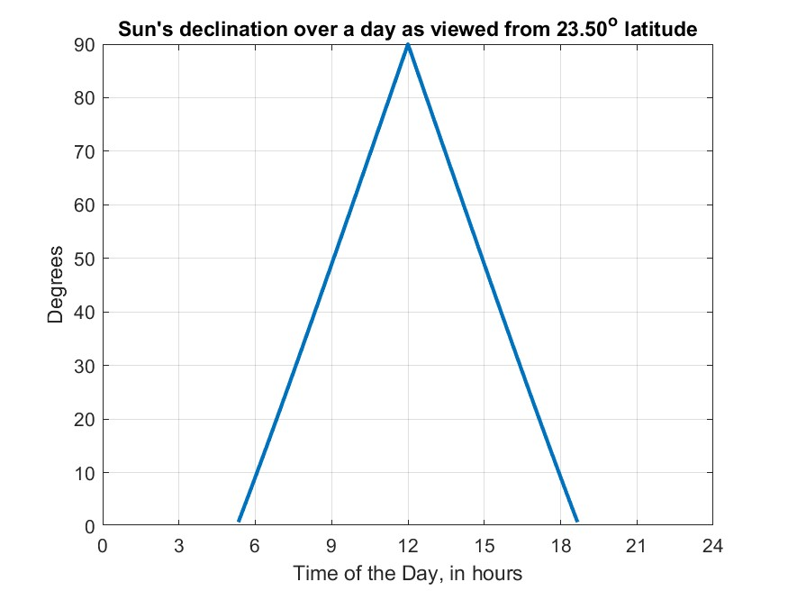
elevation

Slide 18
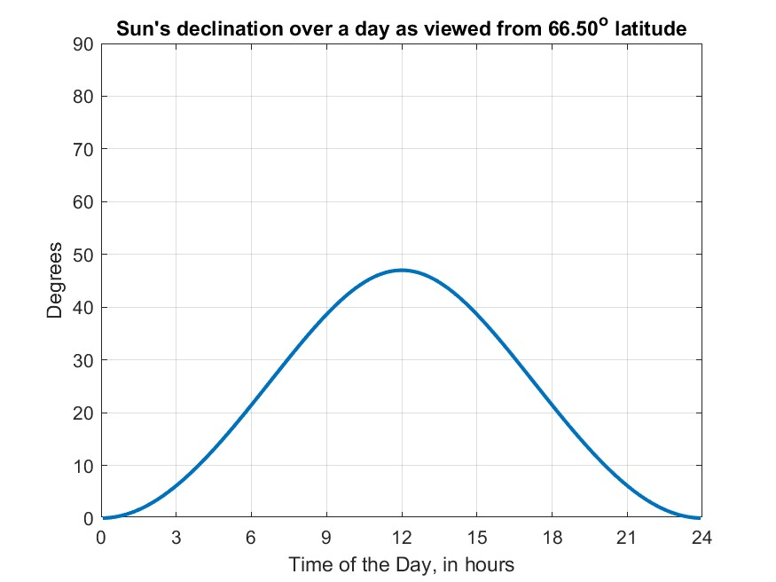
elevation

Slide 19
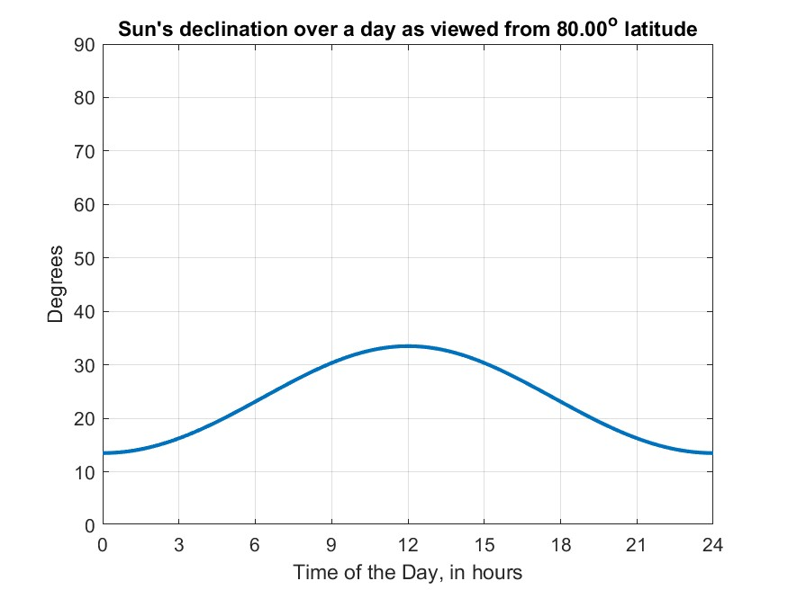
elevation

Slide 20
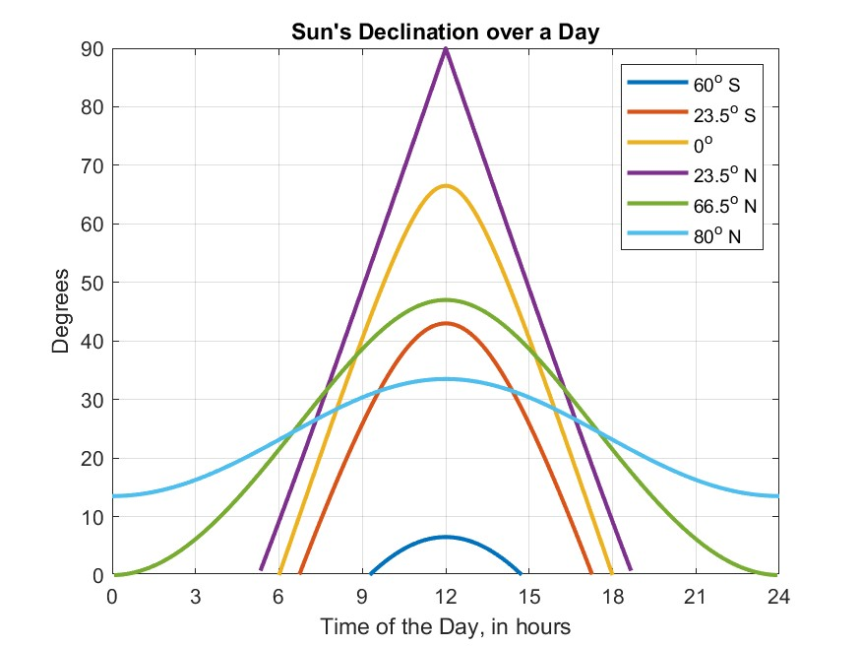
elevation

Slide 21
Spring Equinox
Sun’s Elevation over a Day

Slide 22
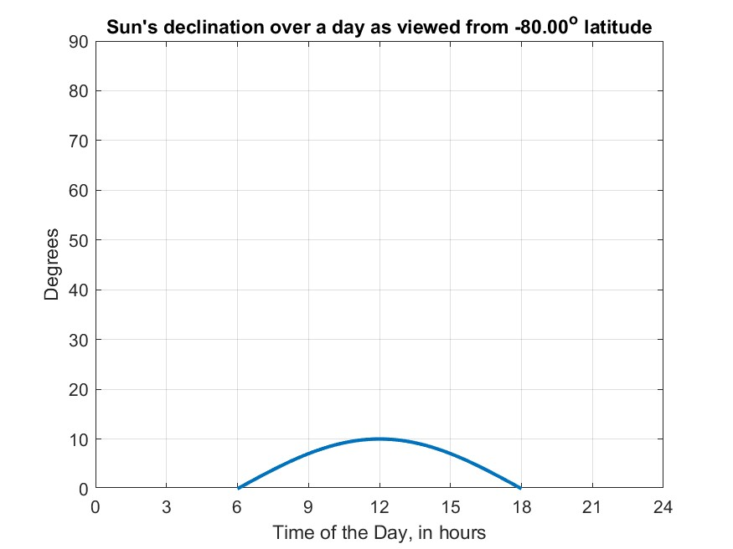
elevation

Slide 23
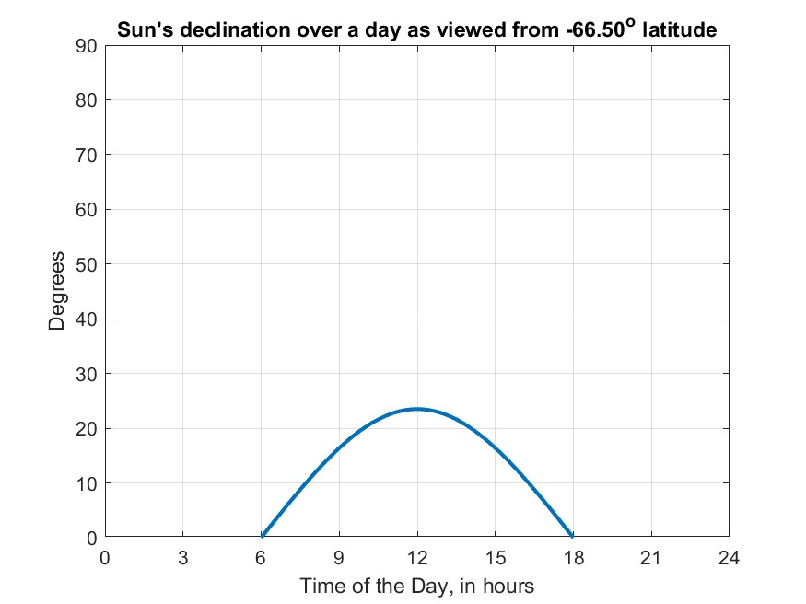
elevation

Slide 24
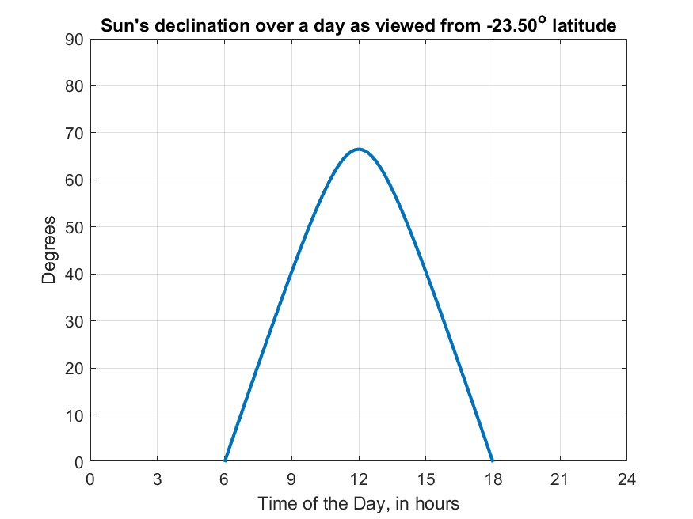
elevation

Slide 25
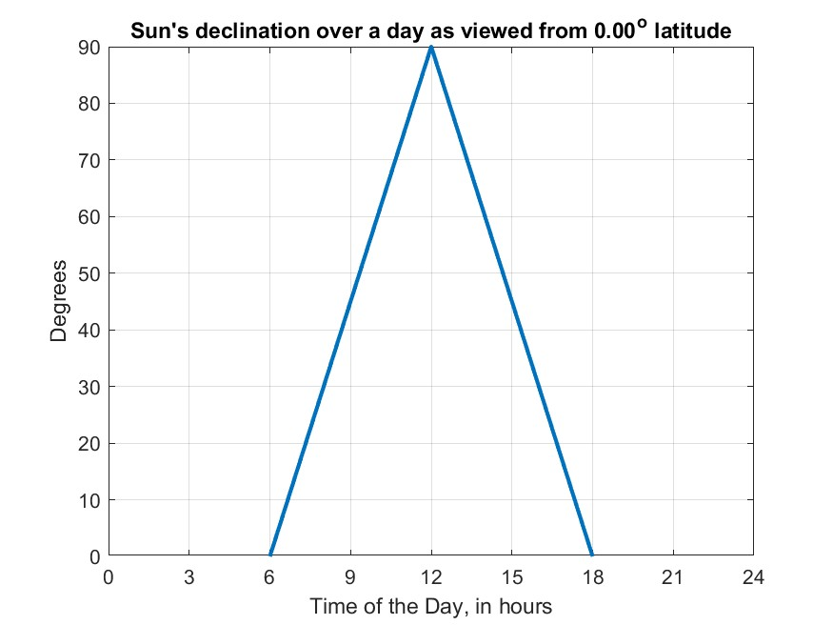
elevation

Slide 26

elevation

Slide 27

elevation

Slide 28
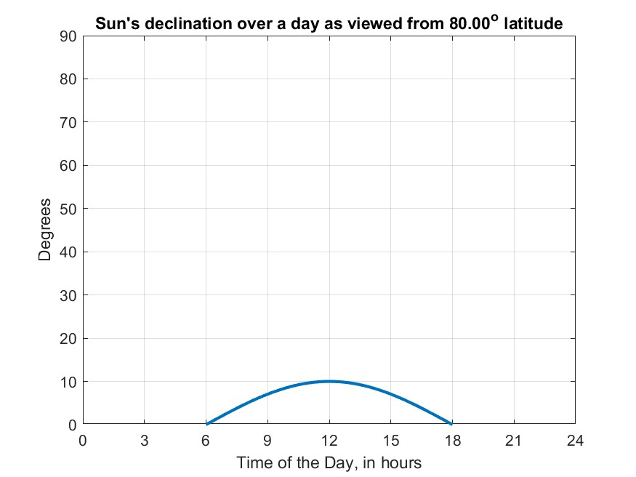
elevation

Slide 29
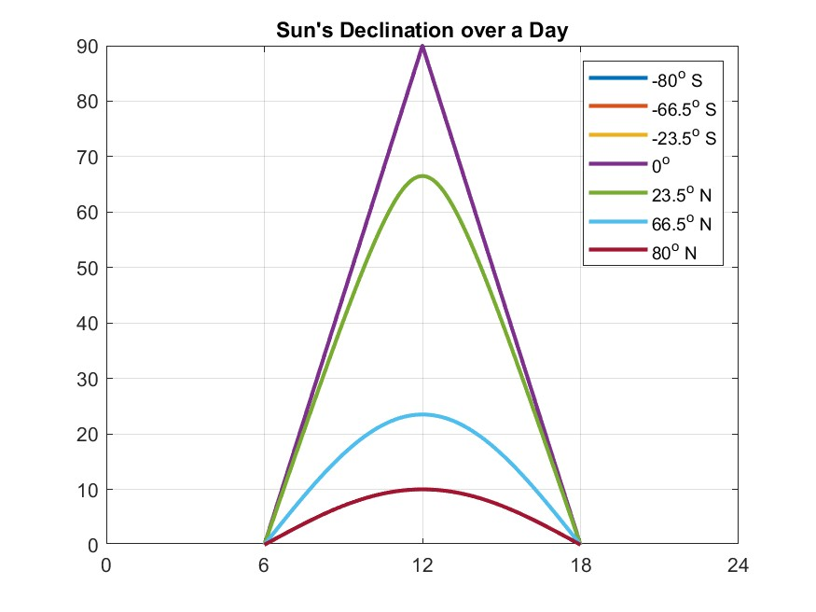
elevation

Slide 30
Spring Equinox
3D Solar Trajectory over a Day

Slide 31
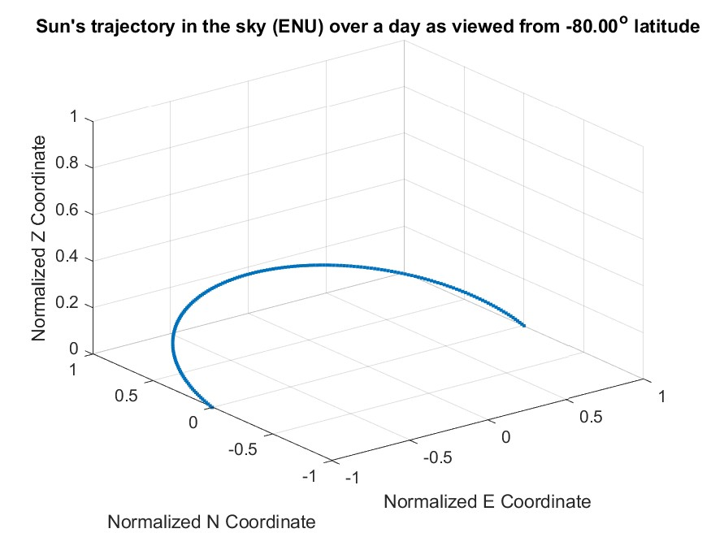

Slide 32
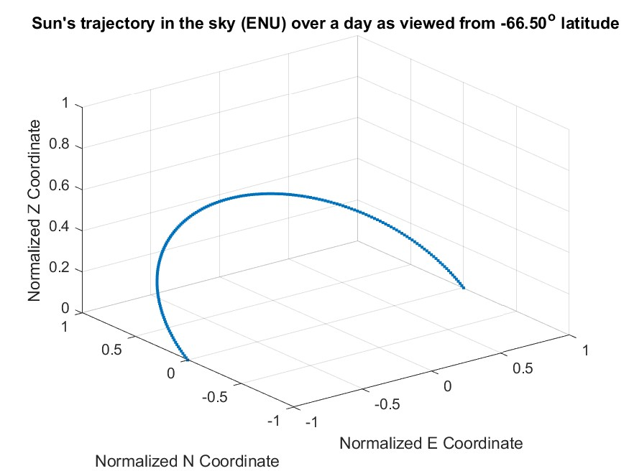

Slide 33
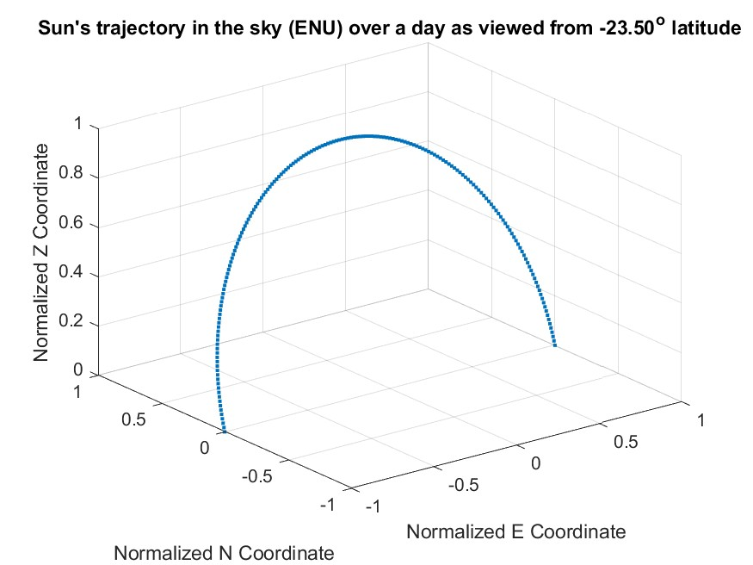

Slide 34
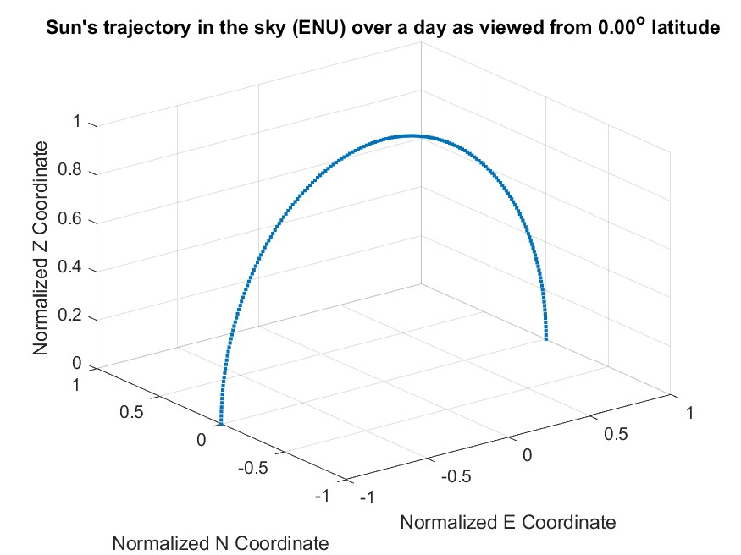

Slide 35
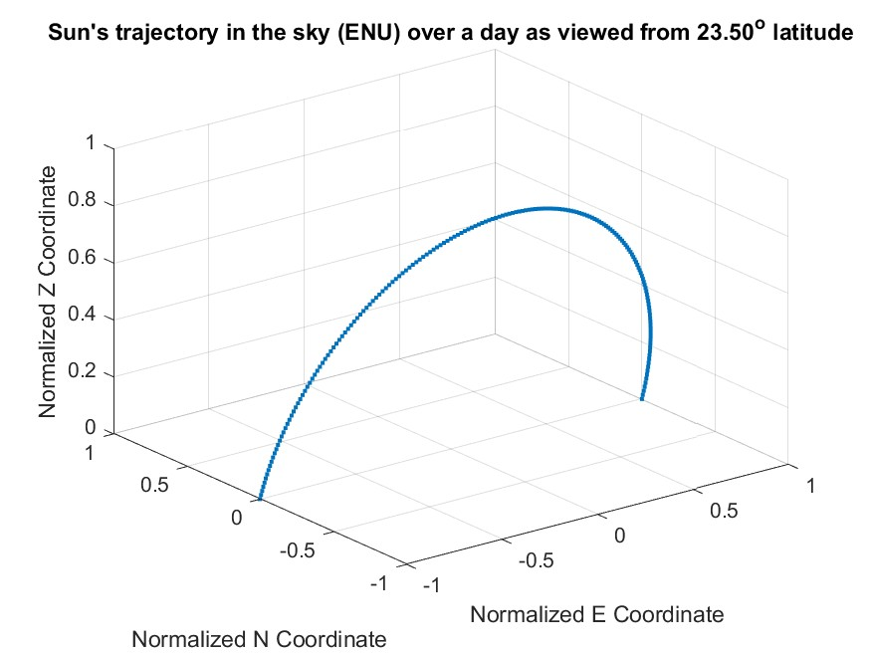

Slide 36
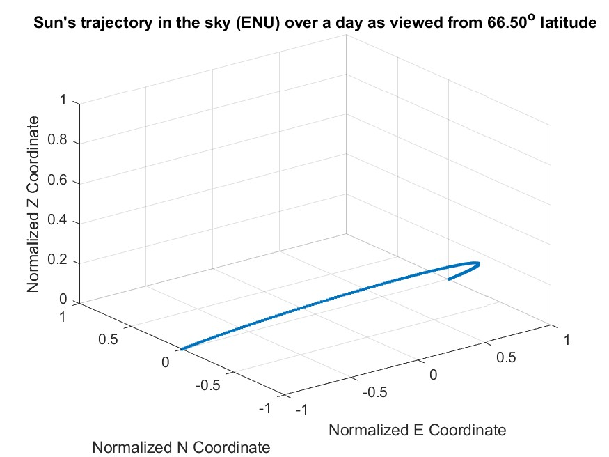

Slide 37
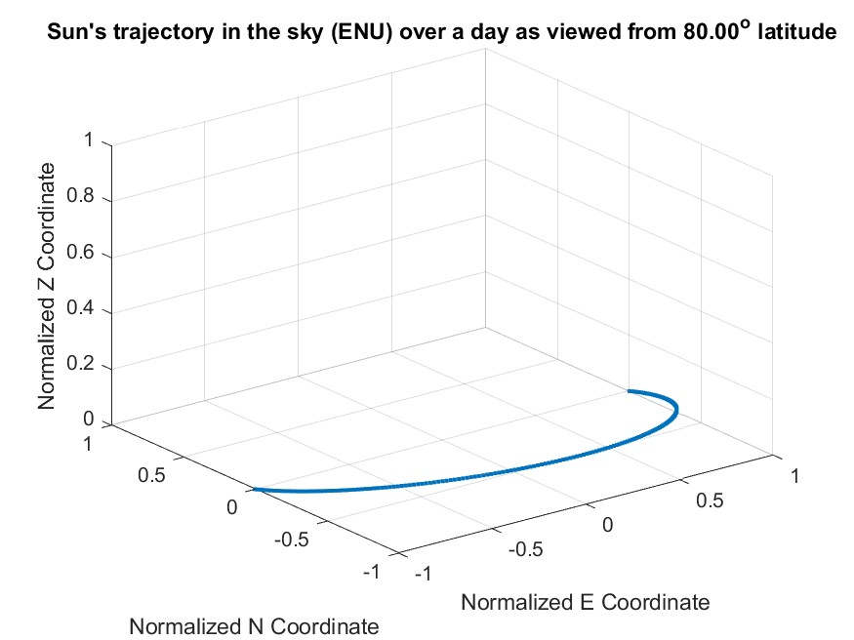

Slide 38
